Slide 1
Introduction to Pregel

Slide 2
Google’s Pregel To the Rescue
Keeps vertices & edges on the machine that performs computation
Uses network transfers only for messages
Think like a vertex
You write the entire program in terms what happens to a vertex. For example
Send a message containing a value to all neighbor vertices
Aggregate the value sent from all neighbor vertices.
Delete a particular edge from my vertex to a neighbor.
Etc.

Slide 3
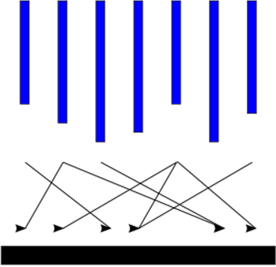
Bulk Synchronous Processing(BSP) Computational Model
Input
Pregel uses the bulk synchronous processing computational model
Input data loaded once during the application
All messaging in memory.
Computation is divided into a sequence of Supersteps.
Each machine gets a subset of the vertices
During each Superstep each machine works in parallel processing the vertices that it is responsible for
Superstep 0
Superstep 1
Superstep 2
….
Superstep n
Output

Slide 4
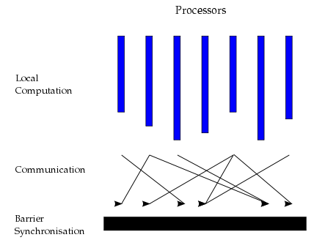
What Happens During Each Superstep?
Each machine runs the same user-defined function on the vertices that it is responsible for
This is done in parallel
Machines send messages to machines containing neighbor vertices.
The barrier synchronization waits for all the machines to have finished receiving messages before moving onto the next Superstep.

Slide 5
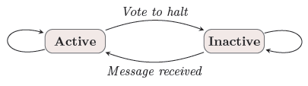
How do we know when to stop?
Each vertex can be in either active or inactive state
Active state means vertex continue to participate in computation at each Superstep.
Inactive state means the vertex has finished its computation and will no longer take part in any future Supersteps.
It will no longer receive any messages and do any further processing.
A vertex moves from active to inactive state by volting to halt.
Entire computation completes when all vertices have volted to halt.
A vertex can be reactivated by receiving an (external) message.

Slide 6
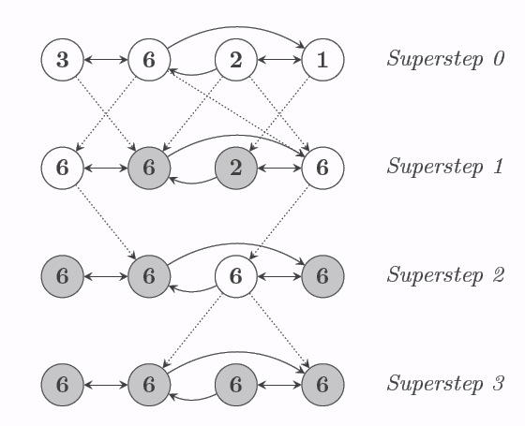
Voting to Halt
Dotted lines are messages
Shaded vertices have voted to halt

Slide 7
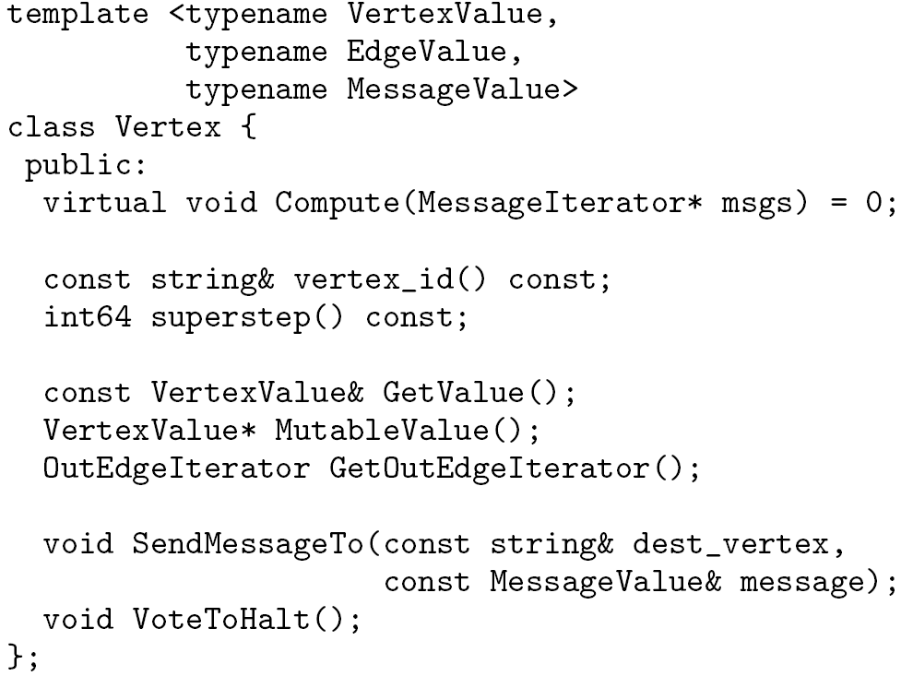
Pregel’s C++ API
Writing a Pregel program
Subclassing the predefined Vertex class
Override this!
in msgs
out msg

Slide 8
PageRank in Pregel
Superstep 0: Value of each vertex is 1.0
virtual void Compute(MessageIterator* msgs) {
if (superstep() >= 1) {
double sum = 0;
for (; !msgs->done(); msgs->Next())
sum += msgs->Value();
// NumVertices is the total number of vertices in graph
*MutableValue() = 0.15/NumVertices() + 0.85 * sum;
}
if (superstep() < 30) {
const int64 n = GetOutEdgeIterator().size();
SendMessageToAllNeighbors(GetValue() / n);
} else {
VoteToHalt();
}
}
The above program first iterates through all messages sent from other nodes to compute the PageRank value for the current vertex
The above program stops when 30 iterations has been reached but you can easily rewrite it to stop when the computation has converged.
While it has not reached 30 iterations the program does the following
Send the contributions of this node to the PageRank of the outgoing neighbors.
Otherwise volt to holt.
1.0
B
A
C
1.0
1.0
1.0
D

Slide 9
Systems Architecture
User programs are copied onto machines.
One machine becomes the master.
Other computer can find the master using name service and register themselves to it.
The master breaks graph into a set of partitions
Tries to create partitions that even the workload and also minimize the number of edges crossing partitions.
The master assigns one or more partitions and a portion of user input to each worker.
The workers run the compute function for active vertices and send the messages asynchronously.
There is one thread for each partition in each worker.
When the superstep is finished workers tell the master how many vertices will be active for next superstep.

Slide 10
Fault Tolerance
Checkpointing
The master periodically instructs the workers to save the state of their partitions to persistent storage.
e.g., Vertex values, edge values, incoming messages.
Failure detection
Using regular “ping” messages.
Recovery
The master reassigns graph partitions to the currently available workers.
The workers all reload their partition state from most recent available checkpoint.

Slide 11
Pregel Summary
“Think like a vertex” computation model
Pregel is a scalable and fault-tolerant platform with an API that is sufficiently flexible to express arbitrary graph algorithms.

Slide 12

Giraph
Hadoop’s version of Pregel
Works over HDFS
Runs on top of Yarn to allow you to share Hadoop cluster with other applications like MapReduce
Based on the same computational model as Pregel
Relies on ZooKeeper as a fault-tolerant coordination service

